Slide 1
PRESENTED BY:
OPEYEMI JAGUNMOLU
BOLANLE ADELEYE
KEHINDE OLUWADAMILARE
Office Supply Data Report For BOK Stores.

Slide 2
INTRODUCTION
BOK Stores is a supply chain that ventures into the supply of office stationery across various states in Nigeria amongst different business segments such as :
Biro
A4 Paper
Pencil
Stapler
Note pad
Marker.
This company has been in existence since 2006, with a proven track record.

Slide 3
EXECUTIVE SUMMARY
This report examines how BOK Stores has performed financially. There’s also an overview of how the products have fared across states and segments with a view of determining the products that generates good outcomes and those with poor outcomes to help in the decision making process of the company.
Findings were made based on the data analysis carried out with Power Bi which is a visualization tool and based on these recommendations were offered to the business.
In this report it was discovered that the key drivers of performance were Biro, Pencil and A4 Paper.

Slide 4
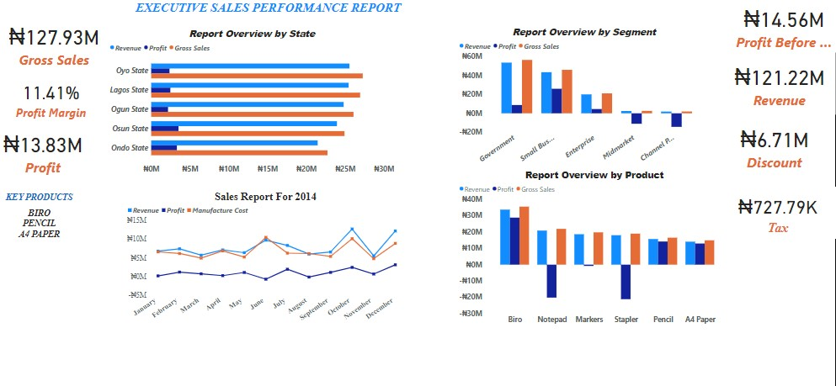
DATA ANALYSIS

Slide 5
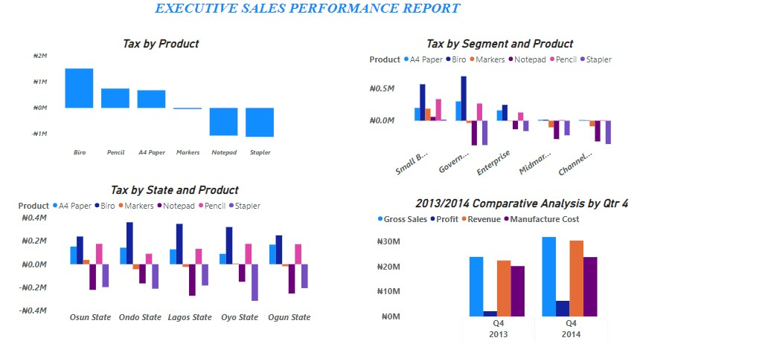
DATA ANALYSIS

Slide 6
KEY FINDINGS
The following are the key findings based on the analysis carried out:
BOK stores made a profit of ₦ 13.83 Million between 2013 and 2014 financial year. Also there was a profit margin of 11.41%.
In the comparative analysis carried out in the fourth quarter of 2013 and 2014, there was an increase in performance by the company.
Biro, A4 paper and Pencil were the products that were key drivers of performance.
Notepad, Stapler and Marker were not performing so well and in turn affected the profit margin of the company.
Tax were paid more on Biro, Osun state also paid more tax amongst the various states, while Government was the segment with the highest tax.
On the financial performance Osun state, Small business and Biro generated the most profit.
In 2014 between January and December, there was growth in the product lines.

Slide 7
RECOMMENDATIONS
The following are the recommendations based on the key findings :
BOK stores should increase capacity in the supply of Biro as it is a major player in the performance of the company. Likewise, A4 paper and Pencil and also enjoy a increase in supply as well as both products are not doing badly.
The company can stop the supply of Marker, Notepad and Stapler as they perform poorly in the financial years reviewed.
Osun state and Small business should enjoy a good attention by the company as these were areas that generated more profit for the company.

Slide 8
CONCLUSION
This report was carried out to review the performance of BOK stores in the supply of office materials such as: Biro, Marker, Notepad, etc. It was discovered that the company had a profit margin of 11.41% between 2013 and 2014 as these were the financial years under review.
A report analysis was done to ascertain the financial performance of the company in order to know the key performers and the under performers.
Some key findings were made based on the executive sales report carried out.
A recommendation was made on the products to continue and also enjoy increase in supply across states and segments.

Slide 9
THANK YOU

